Slide 1



Color Correction for Optical See-Through Displays Using Display Color Profiles
Srikanth Kirshnamachari Sridharan
Dr. Juan David Hincapié-Ramos
Dr. David R. Flatla (University of Dundee)
Dr. Pourang Irani
Notes:
A very good afternoon.
My name is Srikanth Kirhsnamachari Sridharan,
I am a Masters student at university of Manitoba Canada.
Yes I here from half the way across the globe,
The papers I am present is titled “Color Correction for Optical See-Through Displays Using Display Color Profiles”
This work is part of m masters thesis.
Collaborators on in this work are
Dr. Juan David Hincapié-Ramos
Dr. David R. Flatla (University of Dundee)
Dr. Pourang Irani
For this work

Slide 2
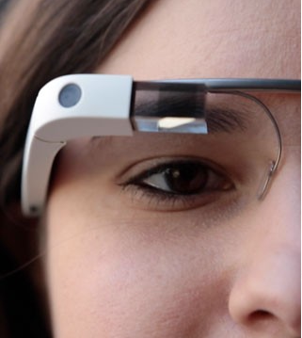
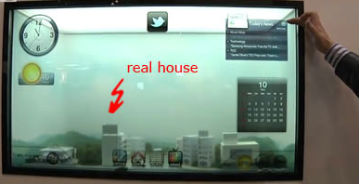
Introduction
Optical see-through displays (OSTD) allow users to view digital content and physical objects simultaneously.
Additive OSTD: Has its own light source
Subtractive OSTD: Filter external light source
Notes:
Jumping into the talk ,
Optical see-through displays or as we call OSTD - allow users to view digital content and physical objects simultaneously
OSTD are of 2 types
Additive & Subtractive
Advantage of having its own light source enables Additive OSTD to have Hardware's of different form factors such as mobiles, HMD, window based displays!

Slide 3
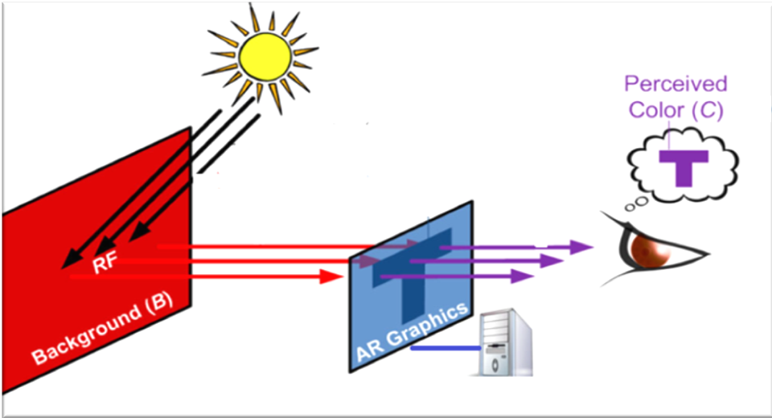
Gabbard et al - More than meets the eye: An engineering study to empirically examine the blending of real and virtual color spaces , VR 2010
Real world background color affects the displayed contents on the digital display
Notes:
However additive OSTD has a problem!
The real world background color mixes with the displayed color.
This phenomenon cause the users perception of the color being displayed to changes from what the color originally is !
Color are essential to clarity of the display, colors help humans to clearly understand the contents on the display.
Color blending negatively affects the usability of such displays as it impacts the legibility and color encodings of digital content.

Slide 4
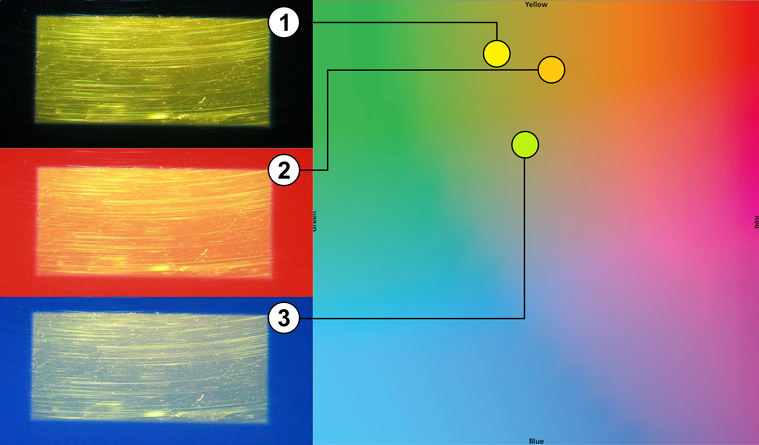
Notes:
This image shows color blending effort on the digital color yellow ,
Here is a OSTD displaying color yellow in 3 different background,
Black background- to the right in the color map you can see yellow being – yellow!
On red background- to the right in the color map you can see yellow being – moved towards red( shows orange)
Blue background-to the right in the color map you can see yellow being – moved towards green

Slide 5
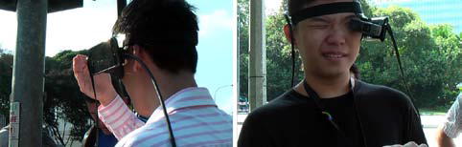
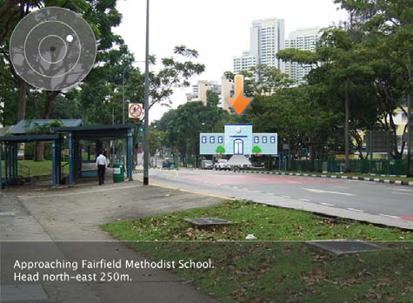
Usability Problem
Kerr et al , Wearable mobile augmented reality: evaluating outdoor
user experience. VRCAI ’11
Notes:
This efforts of background has been studied before by various researchers mostly in the field of Augmented reality.
On usability issues and human perception
One such Eg is,
Kerr et al 2011, studies outdoor use of AR system, where they found on heavy influence from the background users used their hand on have a consistent bg to look at the contents !!
This shows that this influence of the background is a significant problem

Slide 6
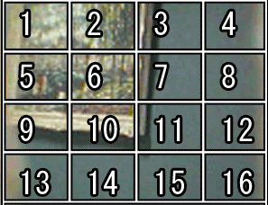
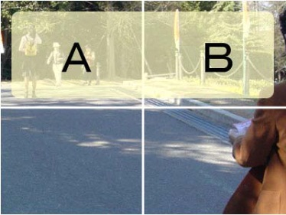
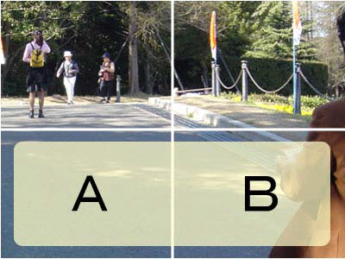
Content Based Solutions
Tanaka et al, An information layout method for an optical see-through head mounted display focusing on the view ability. ISMAR 08
Notes:
Tanaka et al. developed a layout system that relocates digital content to the darker areas of the display taking.
This methods might result in constant shift of the digital content for dynamic background.

Slide 7
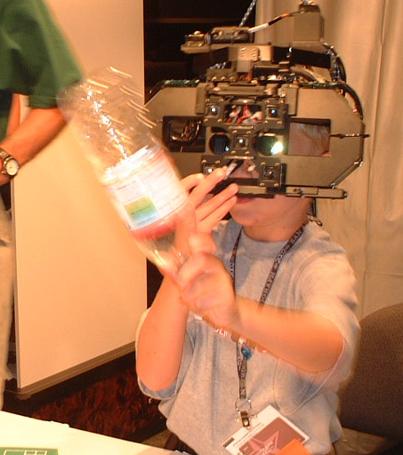
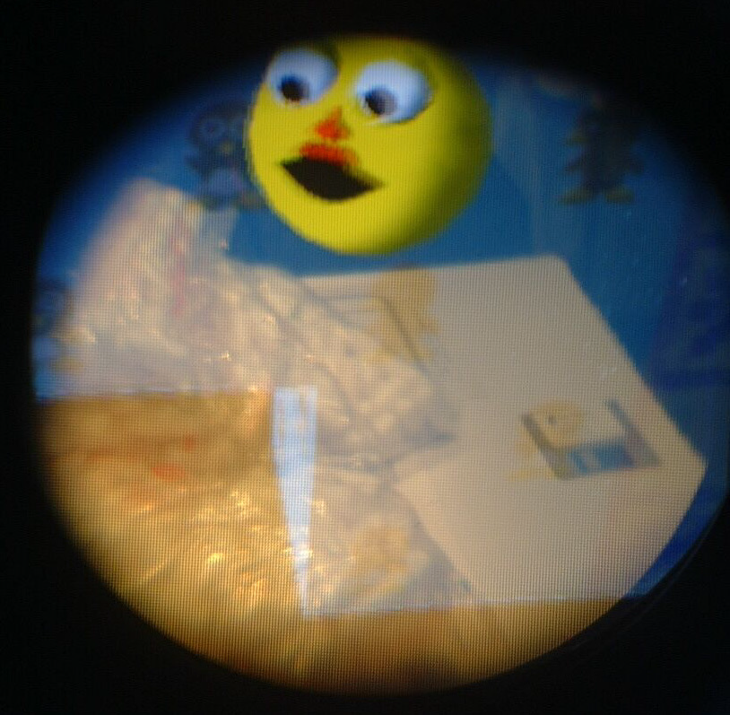
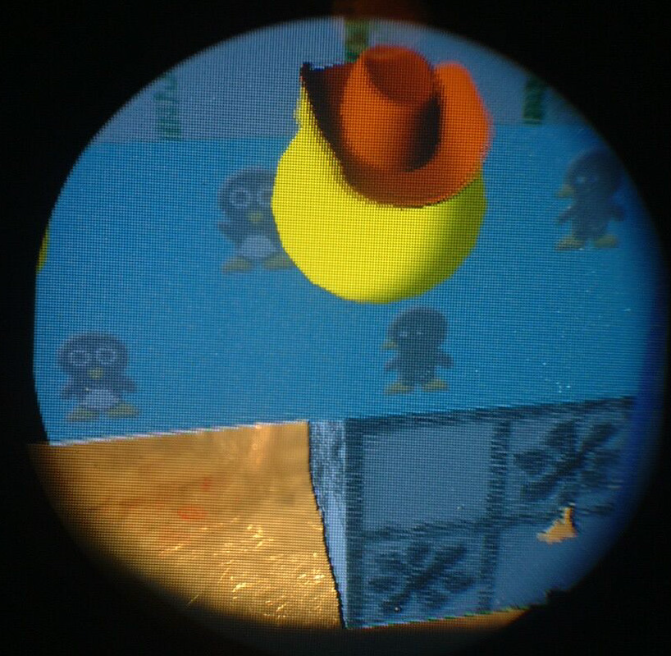
Hardware Based Solution
Kiyokawa et al, An Occlusion-Capable Optical See-through Head Mount Display
for Supporting Co-located Collaboration. ISMAR 2003
Notes:
The main approach to occlusion has been to stop the light coming from the background by enhancing head-mounted displays with spatial light modulation (SLM) devices
Therefore, digital colors projected on the black areas are seen in their original hue and lightness. draw backs being the excess hardware and unavailability of the BG.
(clearly they were not going for style)

Slide 8
How We differ ?
Notes:
We aim not to change the location of UI elements
or
Add new hardware components
We wanted to manipulate the color shown by the display; an approach known as Color Correction.

Slide 9
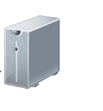
Color Correction
Alternate Color
Background
?
Notes:
Every display shows color a bit different , this is more pronounced in OSTD as each display has different display material, light source etc.
As you can see here the color blue shown is slightly changed when its shown on the display. In our model we account for this change render distortion function.
Similar the OSTD display material changes the color of the BG as it shown here with change in hue of bg color red . We count this by the material distortion function.
We argue in this work the color Belding is a mix of these distorted color than the original colors !!

Slide 10
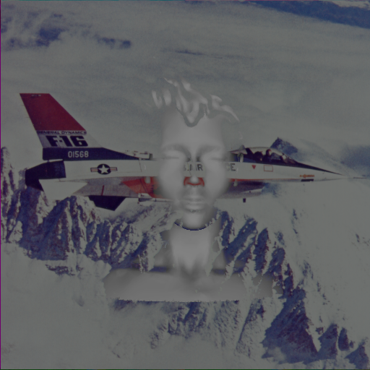
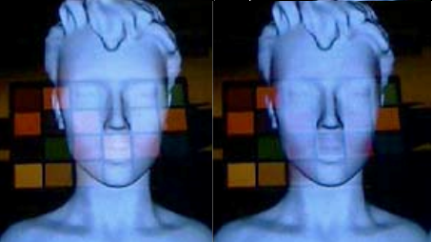
Color Correction in OSTD
Weiland et al, Colorimetric and photometric compensation for optical see-through displays.
Notes:
There are number of works on color correction on spatial augmented reality , in like of projection on textured surface.
But in OSTD the only existing work on color corrections is by
Weiland et al, Colorimetric and photometric compensation for optical see-through displays.
They use foregound color as fed to the system and bg colos as captured
sRGB space was used for color calculations- in which colors accuracy cant be tested
They used Color Subtraction ( Show the second image’s empty spots)

Slide 11
Background
To pick a alternate color we need ability to predict how colors blend on a given display.
We propose a new color blending model that can predict how colors blend on a OSTD
Notes:
Point 1:
To pick a alternate color we need ability to predict how colors blend on a given display.
Without which we cannot really say how the alternate color will look once it blends with the BG.
Point 2:
We propose a new color blending model that can predict how colors blend on a OSTD.
This model is very unique to OSTD, as it address unique problems which are present in OSTD

Slide 12
F(
Bg Color
Background
fmaterial
frender
Blended Color
Blended Color = frender(Digital Color) + fmaterial(Bg Color)
Digital Color
Notes:
Every display shows color a bit different , this is more pronounced in OSTD as each display has different display material, light source etc.
As you can see here the color blue shown is slightly changed when its shown on the display. In our model we account for this change render distortion function.
Similar the OSTD display material changes the color of the BG as it shown here with change in hue of bg color red . We count this by the material distortion function.
We argue in this work the color Belding is a mix of these distorted color than the original colors !!

Slide 13
Contribution
A new Color blending Model for OSTD
Binned Profile (BP) – method to Handel To handle Render Distortion
BP Based Color Correction
Correction analysis of various digital colors
Model/BP Method/Color Correction/Correction Analysis
Notes:
So what is our contributing visa this work ?
A present a new Color blending Model for OSTD
Binned Profile (BP) – To handle Render Distortion
BP Based Color Correction
Design guidelines for OSTD

Slide 14
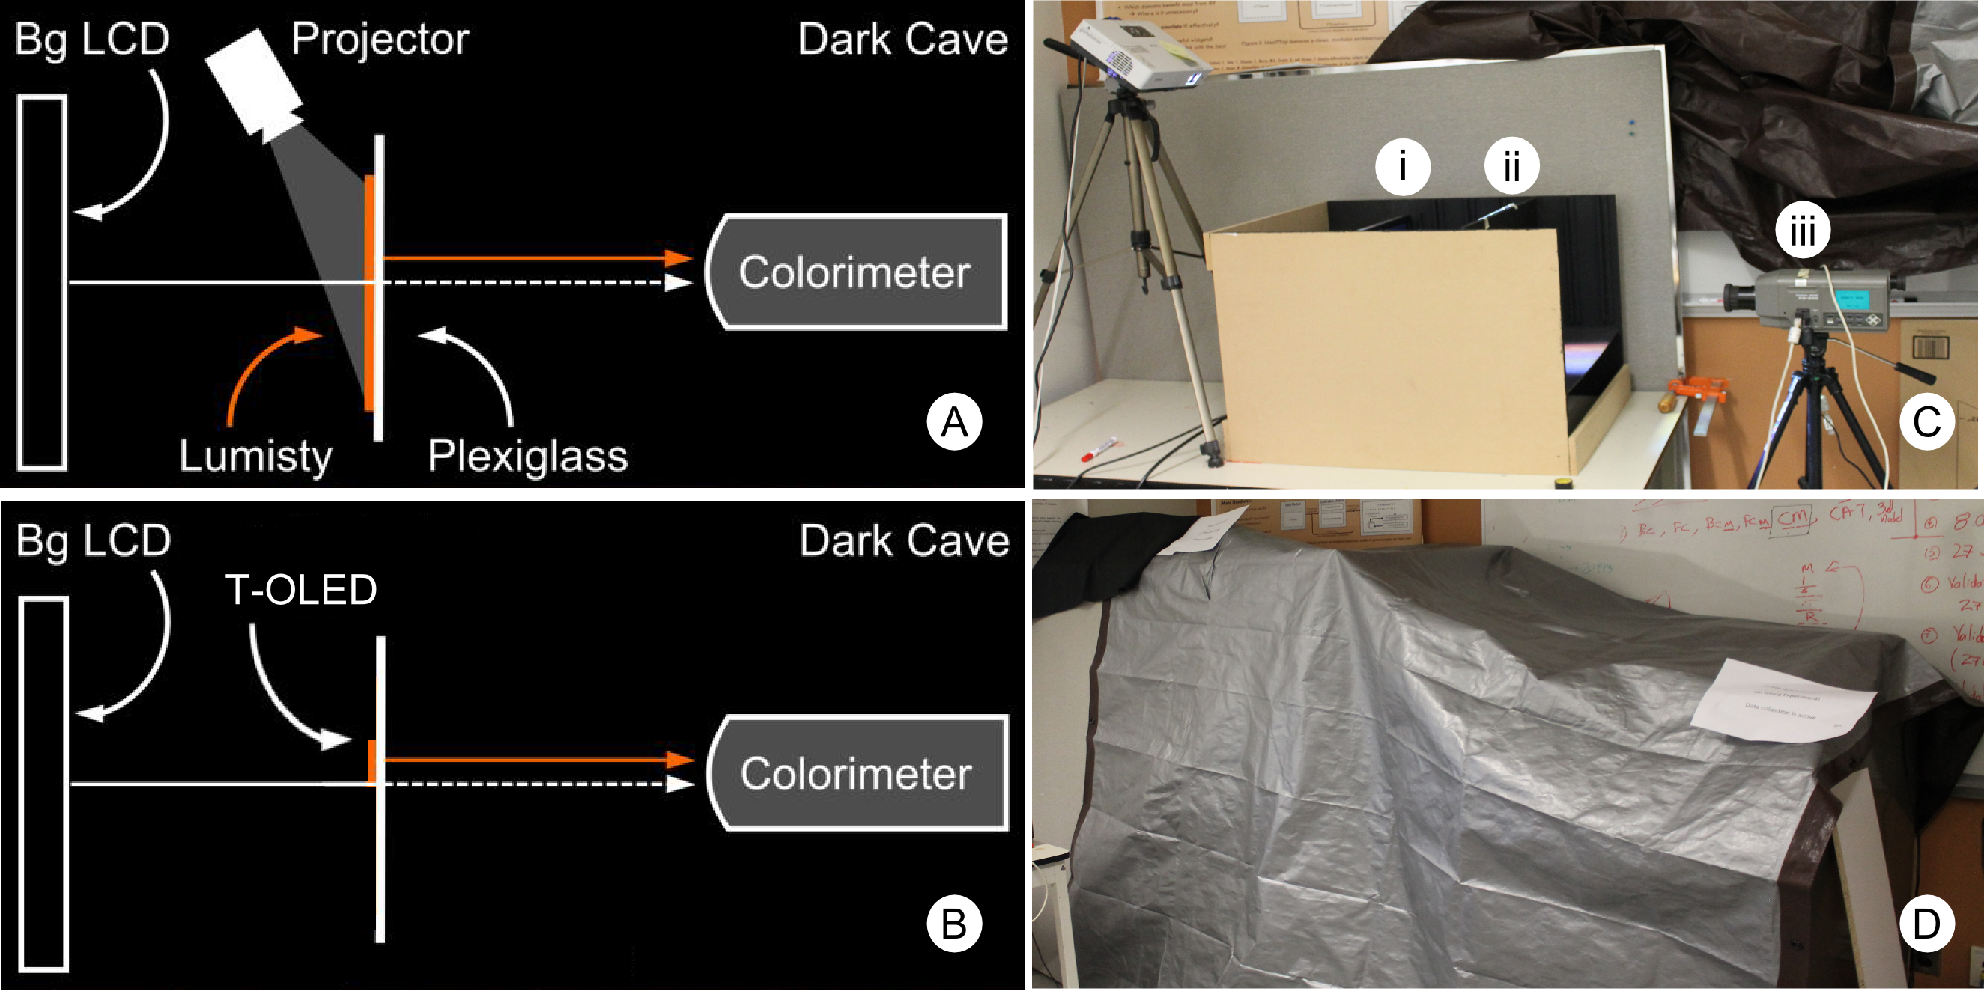
Setup
Notes:
Image on the left shows how the set up was for both projection based and TOLED
Image on the right © shows how the actual setup was.
And image d shows the out light controlled environment
We used cs200 colorimeter to measure the color values.

Slide 15
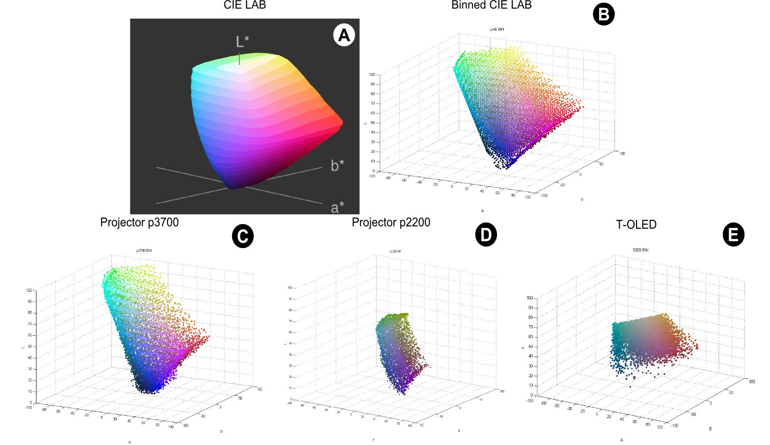
Binned Profile
sRGB colors in LAB space
8376 Binned representative sRGB
p3700
p2200
T-OLED
Model/BP Method/Color Correction/Correction Analysis
Notes:
Divides sRGB color space (over 16 million colors) into a smaller set of 8376 perceptually different bins.
We translated the sRGB gamut into the CIE LAB color space and divided it into bins of 5X5X5
This approach guaranties all colors inside a bin are within one Just Noticeable Difference (1 JND ~ 2.3 in Euclidean distance)
we measured how each bin is rendered by each of our three displays on a black background which is shown here for all 3 displays
P37-hundred had a wide color space and close to sRGB when compared to p2200 and TOLED
Create a look up table which is Binned Profile

Slide 16
BP Method prediction
Binned Profile
Bg Color
Background
Prediction
?
?
Digital Color
Model/BP Method/Color Correction/Correction Analysis
Notes:
We had bp which is a look up table, where we had measurements for all 8000 odd colors ,
So when we wanted to predict how a particular fg will blend with bg , weneed to know how the color is shown in the display
For this we use the BP

Slide 17
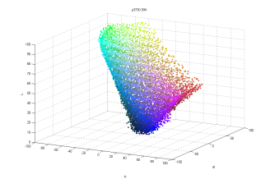
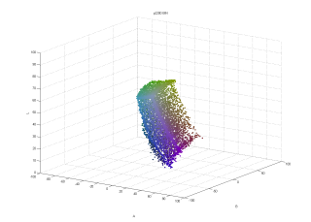
Binned Profile
Foreground
Measured foreground
Digital Color
Model/BP Method/Color Correction/Correction Analysis
Notes:
BP is a look up tabel which has 1-1 reation between all the binned colors and their measured values
So when a digital color is given as input , the system first fits it to the appropriate bin which in turn can give asses to how its measured

Slide 18
BP color prediction
Binned Profile
Bg Color
Background
Prediction
Digital Color
Model/BP Method/Color Correction/Correction Analysis
Notes:
Then add the measured value present in the fg table with the bg , to predict the color

Slide 19
Direct Method prediction
Bg Color
Background
Digital Color
Prediction
?
?
Digital Color
Model/BP Method/Color Correction/Correction Analysis
Notes:
Direct Method:
Synonymous to Weiland et al work
The digital color is simply added to the background
It ignores both render and material distortion

Slide 20
CAT Method prediction
CAT
Transformation
Bg Color
Background
Prediction
?
?
Digital Color
Model/BP Method/Color Correction/Correction Analysis
Notes:
CAT
CAT are established methods to estimate the colors a display can render based on the brightest white it can emit. They are based on matirc converstions
In other words we hoped that they could potentially handle render distortion

Slide 21
Prediction Error
Background
Prediction
Distance in LAB = Error
Measured
Model/BP Method/Color Correction/Correction Analysis
Notes:
We find the error in our prediction by finding equlidiean distance in lab space between the predicted value and the measured blend

Slide 22
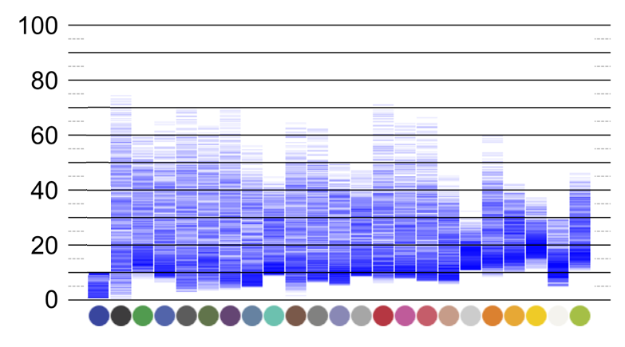
Result Visualization
Prediction Error – Distance in LAB
Bg colors used
Model/BP Method/Color Correction/Correction Analysis
Notes:
We used 838 fg colors on each of our 23 bg colors, measured the blend.
Calculated error value by finding color difference between predicted and measured in Lab.
This visualization shows prediction error value for one condition across 23 bg on for all 838 fg colors
Each point is a prediction error mapped for a bg
First 2 boxes shows:there is a large spread
Box3: shows that for this perticular bg , the preiction error was low ,
Ideally this is how all bg should look for a low error rates
Box4: shows the error spread is concentrated between 10 – 40
the hue of blue indicates more value fell in that region .
Error rate at the bottom near 0, represent prediction with low error rate

Slide 23
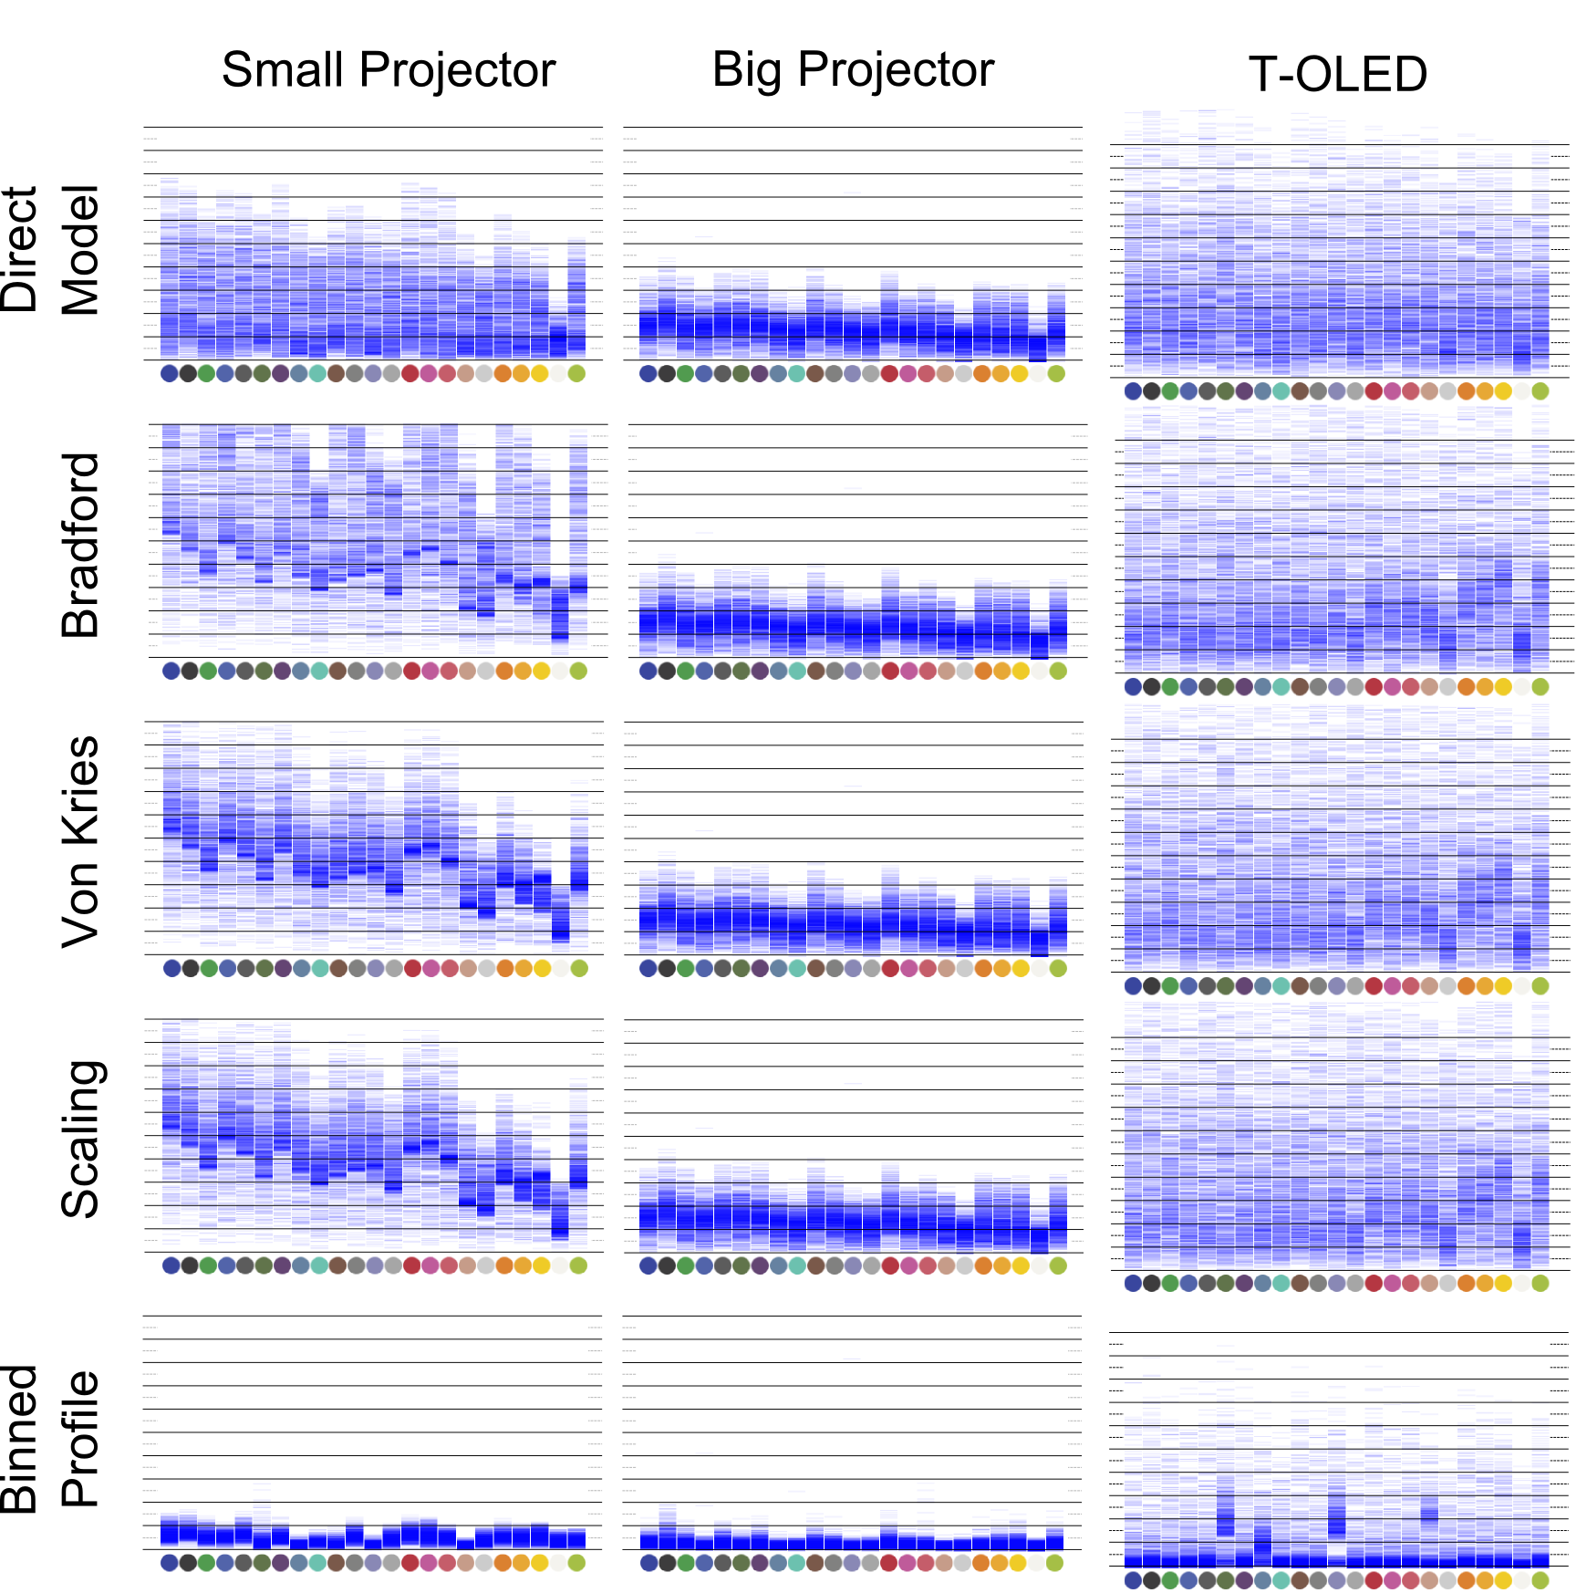
Model/BP Method/Color Correction/Correction Analysis
Notes:
This visualization was used to compare the 5 models we had, over 3 displays in 2 different bg config
Bp In all cases was found to be the most accurate in predicting the blend
This validates the use of BP to predict how colors blend

Slide 24
Color Correction
Background
?
Desired Color
BP Correction Algorithm
?
Digital
Color
Model/BP Method/Color Correction/Correction Analysis
Notes:
When color yellow is shown in red bg , it moves towards orange ,
Color correction needs to find a alternate color which on blending with bg will give yellow
We use BP correction algorithm to pick this alternate error

Slide 25

BP Correction Algorithm
Measured Color (Desired Color)
Digital Color
Return: Color In BP with least distance
Distance in LAB
Bg-Color
Predicted color
BP
(Measured)
Notes:
Alg takes 3 things as i/p
Dc
Bg c
BP of that display
Each measured color in Bin is added with bg to predict how they blend
Then a distance of this preiction is measured against the desiered color
The color in bin with least distance is returned

Slide 26
BP Color Correction
Background
?
Desired Color
Distance in LAB = Error
Measured
BP Correction Algorithm
?
Digital
Color
Model/BP Method/Color Correction/Correction Analysis
Notes:
This color is then applied on the screen
Which happens to be green
The correction error is calculated by finding the distance between the color we desire and the actual blend after correction

Slide 27
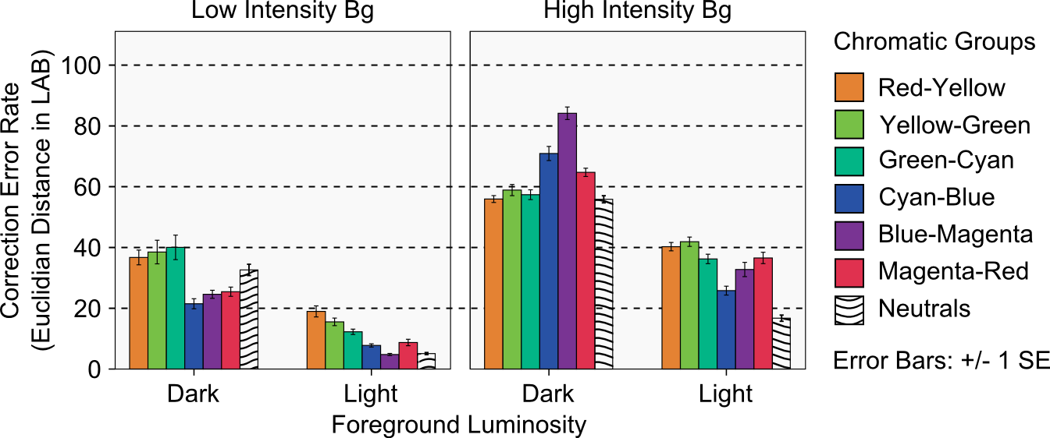
Quantitative Analysis
Kruskal-Wallis test was done, Sig <0.001
Notes:
We generally found neutrals to have low error rate, other than that we found light colors in cyan blue region preforming consistently better among all the other color regions across the bg.
All colors in light region performed better on dark bg
Dark colors in high intensity bg performed the worst !!

Slide 28
Research Implication

Slide 29
Design Implications
Use light neutral colors for information that needs to be preserved best
If more hue is needed, designers can use light colors in the Cyan-Blue region
Dark colors should be avoided for text and color-encoded information
Usage of color themes based on the background will be wise
Notes:
A UI designer for OSTD show keep following points in mind
Use Light neutral colors for information that needs to be preserved best (text , icons etc)
If more hue is needed, designers can use light colors in the Cyan-Blue region (alerts)
Dark colors should be avoided for text and color-encoded information
Usage of color themes based on the background will be wise
Have in mind there we are not recommending these to preserve contrast we are more concern about color

Slide 30
Future Work
Notes:
We are currently working on a algorithm which is not brute force.
Also working to implement this on a HMD

Slide 31
Take Away

Slide 32


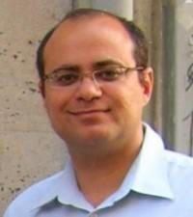

Acknowledgements
Dr. Juan David Hincapié-Ramos
Dr. Pourang Irani
Dr. David R. Flatla
Special thanks to Jango Guo
NSERC for funding and people at HCI lab In university of Manitoba

Slide 33

Thank you, Questions?
Presented by,
Srikanth Kirshnamachari Sridharan

Slide 34
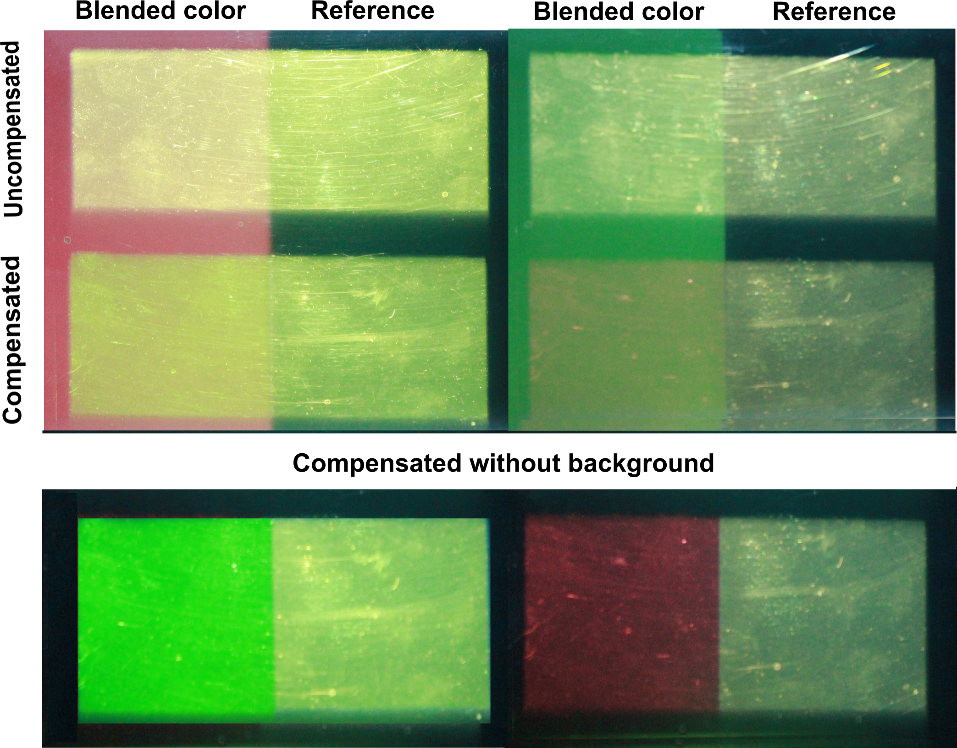
Notes:
Example of the system working

Slide 35
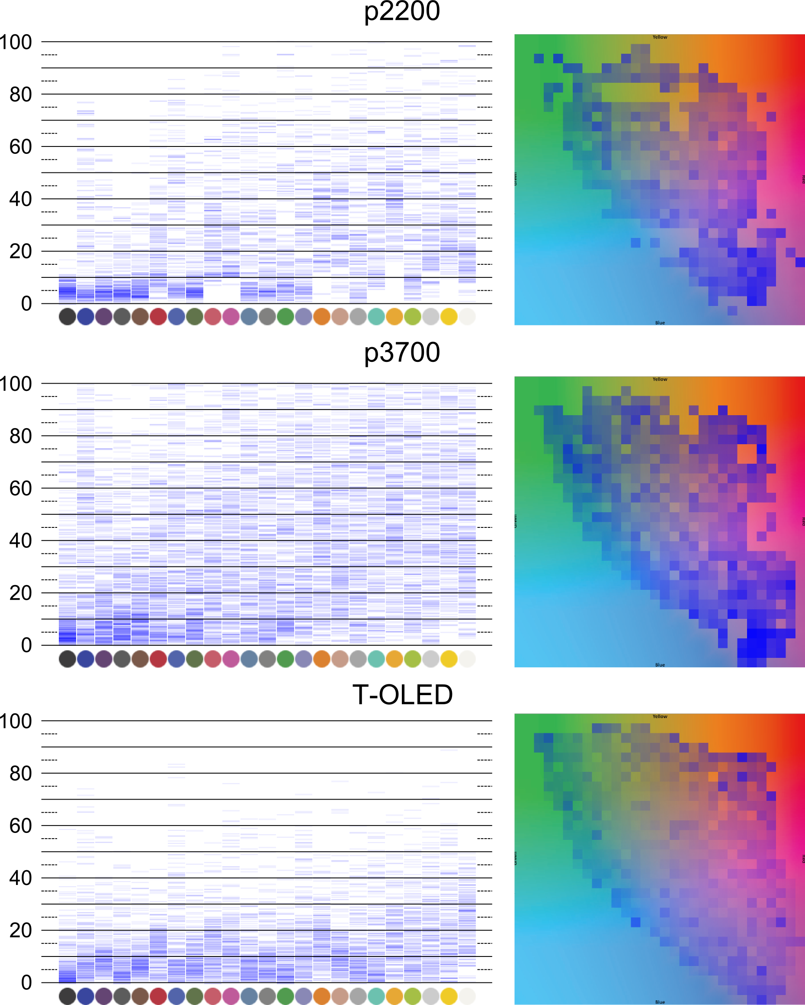
Result
Model/BP Method/Color Correction/Correction Analysis
Notes:
We created correction heat maps for all 3 displays,
The heat map shows generally colors for p22-hundered and TOLED were better corrected than the p3700
This is due the both these displays have limited color profile, so the distqance between a color to shown in bin and how it measured fg will always be small.
We also found a trend in fg color always got corrected better for low intensity bg , with the correction error increasing with the intensity of the bg.
We took the p3700 and studied it further has it had wider range colors , which are typlically needed for rich multimedia contests

Slide 36
Notes:
Cat fg colors

Slide 37
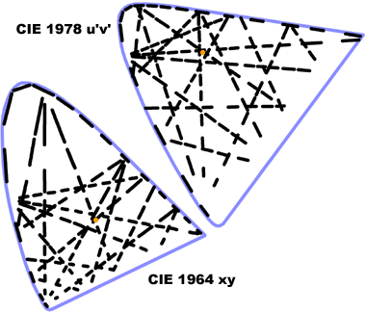
Just Noticeable Difference
Notes:
JND is the Euclidian distance between 2 given color in a color space with in which the colors appear same to humans.
In XYZ space it varies with each color, but in uniform spaces like LAB and LUV its constant number ( 2.5 in lab).

Slide 38
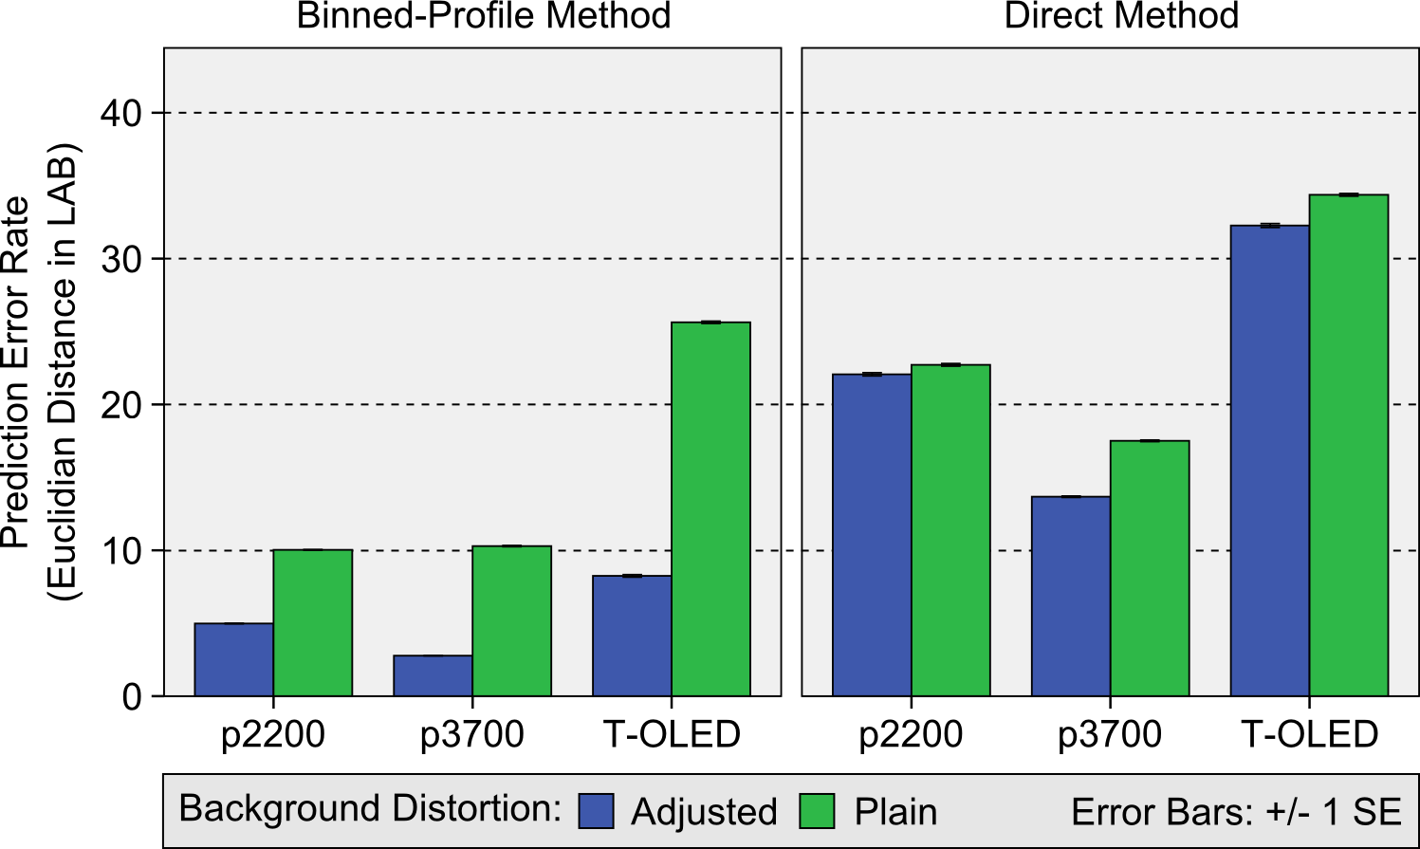
Quantitative analysis
Kruskal-Wallis test was done, Sig <0.001
Notes:
We decided to do quantitative analysis for bp and direct model.
Here green bars rep bg in plain config, blue bars rep bg in adjusted config
Graph shown there is a fall in green pars perdition error between bp and direct model for all 3 displays.
This shows accounting for render distortion with the help of bp decreases the prediction error.
While both the distortions were accounted for the prediction accuracy increased as shown in the graph comparison between plain and adjusted config using bp on all 3 displays.
However addressing only the material distortion , does little change to the error rate
this result shows the render distortion constitutes the core of color blening in OSTD

Slide 39
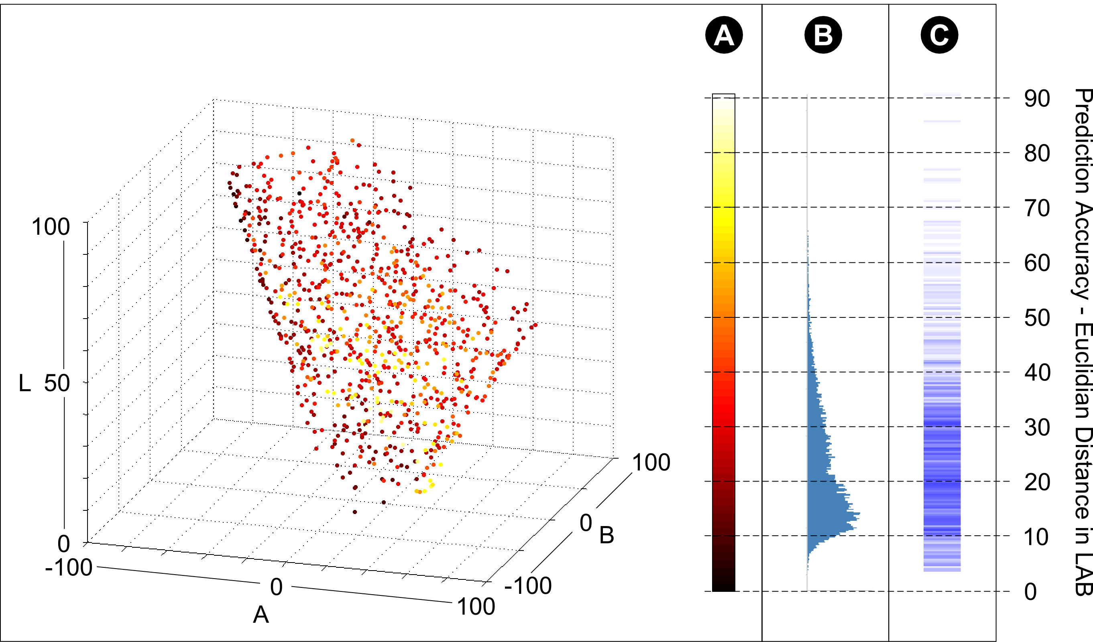
Result
Notes:
Prediction result viz

